Slide 1


Telecom Egypt Intelligent Assistant
Production-Ready RAG Chatbot
✓
Powered by official website (te.eg) + user uploads
✓
Multilingual support: Arabic, Egyptian dialect, English
✓
Grounded answers with automatic source citations
✓
Enterprise-grade security and scalability
Presenter: Mohamed Saeed Abu Samaha Date: 08/01/2026

Slide 2

Agenda
1
Problem & Goals
2
High-Level Architecture
3
Web Scraping (Scrapy)
4
File Upload & Processing
5
Chunking & Recursive Chunking
6
Embeddings (multilingual-e5)
7
Vector DB: Qdrant Cloud
8
LLM: Groq LLaMA-3.3-70b
9
Setup Script (Crawl → Index)
10
Streamlit UI
11
Security & Monitoring
12
Demo & Next Steps

Slide 3





Problem & Goals
The Problem
Our Goals
Answer questions grounded on official te.eg website
1000s
Daily customer inquiries about plans, billing, and technical support
Support Arabic, Egyptian dialect, and English seamlessly
Allow file uploads (PDF, DOCX, TXT, HTML, Images)
⏱️
Provide source citations for all answers
Manual responses are time-consuming and inconsistent
Deliver professional, user-friendly interface
🌍
Customers speak Arabic, Egyptian dialect, and English

Slide 4



High-Level Architecture
Frontend Layer
Backend Layer
Data Layer
Streamlit UI - Chat interface, file uploads, language selection, source citations
FastAPI - REST API endpoints, request validation, response formatting
Qdrant Vector Database - Stores embeddings, metadata, and enables similarity search
🔍
Retrieval Service
🧠
LLM Integration
🕷️
Scrapy Crawlers
📦
File Storage
📄
Document Processing
⚙️
Indexing Pipeline
📊
Metadata Store
🌍
Language Detection
Data Ingestion
Embedding & Indexing
Query & Response
Scrapy crawls te.eg + users upload files → parsed and chunked
Chunks embedded with multilingual-e5 → stored in Qdrant
User query → retrieve relevant chunks → LLM generates answer

Slide 5



Web Scraping: Scrapy + BeautifulSoup
Why Scrapy?
BeautifulSoup Extraction
✓
Robust crawling framework with built-in rate limiting
✓
HTML parsing and DOM traversal
✓
Resumable jobs for long-running crawls
✓
CSS selectors and XPath for element extraction
✓
Automatic sitemap parsing and URL discovery
✓
Text cleaning and whitespace normalization
✓
Middleware for handling cookies and sessions
✓
Handles malformed HTML gracefully
✓
Respects robots.txt and politeness delays
✓
Language-aware text extraction
✓
Built-in caching and deduplication
✓
Metadata preservation (links, attributes)
Key Features
Key Outputs Per Page
Scalable spider architecture with concurrent request handling and automatic backoff on server errors
URL (source reference)
→
Title & headings
→
Main text content
→
Fetch date & timestamp
→
Content hash (deduplication)
→
Language detection
→

Slide 6










File Upload & Processing Pipeline
Step 1: Upload via Streamlit
User uploads file through Streamlit interface → stored in object storage or local filesystem
Step 2: Worker Processes File
Background worker picks up file and begins processing pipeline
Step 3: Parse Text Content
Extract text using pdfplumber (PDF), python-docx (DOCX), HTML parser, or Tesseract OCR (images)
Step 4: Normalize Text
Clean whitespace, remove special characters, standardize encoding
Step 5: Language Detection & Chunking
Detect language (Arabic, English, Egyptian dialect) → pass to recursive chunker
Supported File Formats
PDF
DOCX
TXT
HTML
Images (OCR)
⚠️ Note: User consent required before indexing uploads into vector database

Slide 7


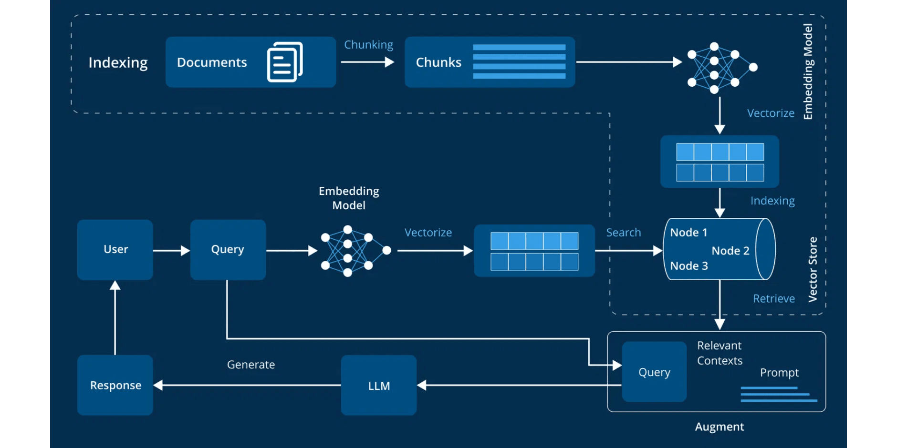



Recursive Chunking Strategy
Technical Parameters
Max Tokens:
~500 tokens (200-300 words)
Overlap:
20-30% (50-100 words)
Document
Metadata:
chunk_id, doc_id, url, title, heading, lang, fetch_date, content_hash
Full content from website or upload
↓
Sections
Split by headings and major divisions
↓
Paragraphs
Logical units within sections
↓
Sub-units
If paragraph exceeds max tokens
Key Benefits
Prevents arbitrary sentence cuts
✓
Honors document structure
✓
Optimal chunk size for embeddings
✓
Preserves context across boundaries
✓

Slide 8



Multilingual Embeddings
Embedding Model
Processing Pipeline
intfloat/multilingual-e5-large
Batch Processing
Process multiple chunks simultaneously for maximum throughput and efficiency
State-of-the-art multilingual embedding model with exceptional support for Arabic and dialectal variations.
Strong Arabic language support
GPU Acceleration
Handles Egyptian dialect effectively
Leverage CUDA for 10-50x speedup in embedding generation
Cross-lingual semantic understanding
1024-dimensional output vectors
Optimized for semantic search
Vector Normalization
Normalize embeddings for cosine similarity and optimal retrieval
Persistent Storage
Output Dimension
Languages Supported
Save embeddings with metadata for fast retrieval and reuse
1024
100+

Slide 9



Vector Database: Qdrant Cloud
Collection Configuration
Point Structure
Collection Name:
telecom_chunks
ID
Distance Metric:
COSINE (or DOT with normalized vectors)
Unique identifier: docID::chunkID for deduplication
Vector Size:
1024 dimensions (from multilingual-e5)
Vector
1024-dimensional embedding from multilingual-e5-large
Storage Type:
Qdrant Cloud (managed service)
Payload
Indexing:
HNSW (Hierarchical Navigable Small World)
Metadata object containing source info and content
Payload Contents
url
title
chunk_text
language
content_hash
fetch_date
Batch Operations & Filtering
Batch Upsert
Similarity Search
Language Filtering
Insert/update points in batches of 256-1024 for optimal throughput and memory efficiency
Query vector against collection to find top-K most similar chunks with configurable limits
Filter results by language field to improve retrieval relevance for multilingual queries

Slide 10



LLM: Groq LLaMA-3.3-70b
Model & Deployment
RAG Prompt & Processing
Groq LLaMA-3.3-70b-versatile
Prompt Template Structure
Provider: Groq (managed endpoint)
SYSTEM: You are a helpful assistant...
Context Window: 8,192 tokens
SOURCES:
[Top-K retrieved chunks]
Latency: Ultra-low (milliseconds)
INSTRUCTION:
Role: Answer generation & context consolidation
"Answer only using sources."
"If not found, say so."
"Cite sources."
Key Capabilities
Multi-lingual understanding
Post-Processing
Arabic dialect support
Instruction following
Citation Validation
Citation generation
Ensure every factual claim has at least one source citation
Reasoning over contexts
Confidence Scoring
Calculate confidence based on source relevance and agreement
Response Time
Throughput
Source Linking
<2s
1000+/hr
Link citations to original URLs and document metadata

Slide 11







Setup Pipeline: Crawl → Index → Upsert
Web Crawling
File Processing
Normalization
Recursive Chunking
Batch Embeddings
Qdrant Upsert
Scrapy crawls te.eg and extracts HTML
Parse PDF, DOCX, TXT, HTML, Images
Clean text & detect language
Generate 1024-dim vectors
Store in vector database
Split into 500-token chunks
↓
↓
↓
↓
↓
Crawling Config
Chunking Config
Batch Processing
Domain: te.eg
Max tokens: ~500
Embedding batch: 32 chunks
Max depth: 5 levels
Overlap: 20-30%
Qdrant batch: 256-1024 points
Timeout: 30s per page
Separators: Hierarchical
Idempotent: Yes (upsert mode)
Retry: 3 attempts
Metadata: Preserved
Error recovery: Automatic retry
Robots.txt: Respected
Dedup: Content hash
Logging: Comprehensive
Performance Metrics (Typical Run)
Pages Crawled
Chunks Generated
Embeddings Created
Total Runtime
50-100
500-1000
500-1000
10-15 min

Slide 12









Streamlit UI Features
Chat Interface
Source Citations
Message History
Citation Display
Full conversation history with timestamps, user/assistant roles, and persistent storage
📌 Source 1:
"WE Space offers high-speed internet..." — https://te.eg/services/we-space
Language Selector
📌 Source 2:
Dropdown to select English, Arabic, or Egyptian Dialect for query and response
"Pricing starts at 199 EGP/month..." — Uploaded Document: pricing_2024.pdf
Admin Panel
Query Input
Text area with auto-detection of language and dialect from user input
Admin Controls
Re-index Collections — Trigger full re-crawl and re-embedding
Clear Chat
Collection Stats — View document count, chunk count, embedding status
One-click button to clear conversation history and start fresh
Health Check — Monitor backend, Qdrant, and LLM service status
Export Data — Download indexed documents and metadata
Configuration — Adjust retrieval parameters and LLM settings

Slide 13









Security, Monitoring & Deployment
Security
Monitoring
Docker Compose
Single-command deployment for development and small-scale production
API Key Management
Structured Logging
Environment variables for Groq, Qdrant, and embedding service credentials
JSON-formatted logs with timestamps, levels, and context
Quick Start
Loguru integration for file and console output
Kubernetes
Encrypted storage
Enterprise-grade orchestration with auto-scaling, load balancing, and rolling updates
Performance Metrics
File Validation
Track query latency, embedding time, and LLM response time
Production Ready
Type checking, size limits (max 50MB), virus scanning
Query Latency
Throughput
Supported: PDF, DOCX, TXT, HTML, PNG, JPG
<2s avg
1000+/hr
AWS ECS
Managed container service with CloudWatch monitoring and auto-scaling
CORS Configuration
Health Checks
Restrict API access to authorized frontend domains
Monitor Qdrant, LLM, and embedding service availability
Cloud Native
Configurable allowed origins
/api/health endpoint with component status
GCP Cloud Run
SSL/TLS Encryption
Error Tracking
Serverless deployment with automatic scaling and pay-per-use pricing
End-to-end encryption for data in transit
Capture and log exceptions with full stack traces
Serverless
HTTPS enforced
Sentry integration ready
Usage Analytics
Azure Container
Rate Limiting
Managed container instances with integrated monitoring and networking
Prevent abuse with request throttling
Track queries by language, document uploads, and user patterns
100 requests/min per IP
Enterprise

Slide 14




Next Steps & Roadmap
2026 Quarterly Roadmap
Q1 2026
→
Q2 2026
→
Q3 2026
→
Q4 2026
January - March
April - June
July - September
October - December
Feedback loops for incorrect answers
Support ticket escalation
Expanded crawling to microsites
Fine-tuning for dialectal phrasing
User satisfaction tracking & NPS
CRM integration (Salesforce/HubSpot)
Content freshness monitoring
Model optimization & distillation
Performance optimization
Advanced analytics dashboard
Mobile app version
Enterprise SLA & support tiers
Strategic Initiatives Beyond 2026
2026 Success Metrics
User Satisfaction
≥ 4.5/5.0
Model Fine-Tuning
Multi-Regional Deployment
Autonomous Agents
Query Resolution
Train custom Telecom Egypt models for improved accuracy
Enable actions (bill payments, service changes) with auth
≥ 85%
Expand to other operators in MENA with localized KBs
System Uptime
99.9%
Response Time
< 2 seconds

Slide 15





Thank You
For your attention and interest in the Telecom Egypt Intelligent Assistant
Questions & Discussion
We welcome your questions, feedback, and ideas for improvement. Let's discuss how this RAG system can transform customer support at Telecom Egypt.
Email
Documentation
Live Demo
support@telecom-egypt.ai
github.com/telecom-egypt/rag-assistant
demo.telecom-egypt.ai
The complete source code, documentation, and deployment guides are available in the project repository. Thank you for considering this solution!

